Slide 1
Authentic Spirituality
Matthew 7:12-21

Slide 2
Diversity is the New Religion today The diversity/religion mindset comes directly from Postmodernism The theory that truth is relative diversity seeks the approval of men, not God

Slide 3
The wide gate
The real mindset behind diversity is a tacit atheism
A Trinity of Personal Choice – Self-aggrandisement – Self-indulgence
The main trouble with relativism is the absence of truth

Slide 4
There are only two kinds of people in the end: those who say to God, "Thy will be done," and those to whom God says, in the end, "Thy will be done." All that are in Hell, choose it. Without that self-choice there could be no Hell. No soul that seriously and constantly desires joy will ever miss it. Those who seek find. Those who knock it is opened.

Slide 5
The narrow gate
Jesus invites people to go through the narrow gate – it is a command to respond
We must enter through the gate alone
We must enter the gate with difficulty
We enter the narrow gate with nothing except our cross
We must enter the narrow gate in submission to Christ

Slide 6
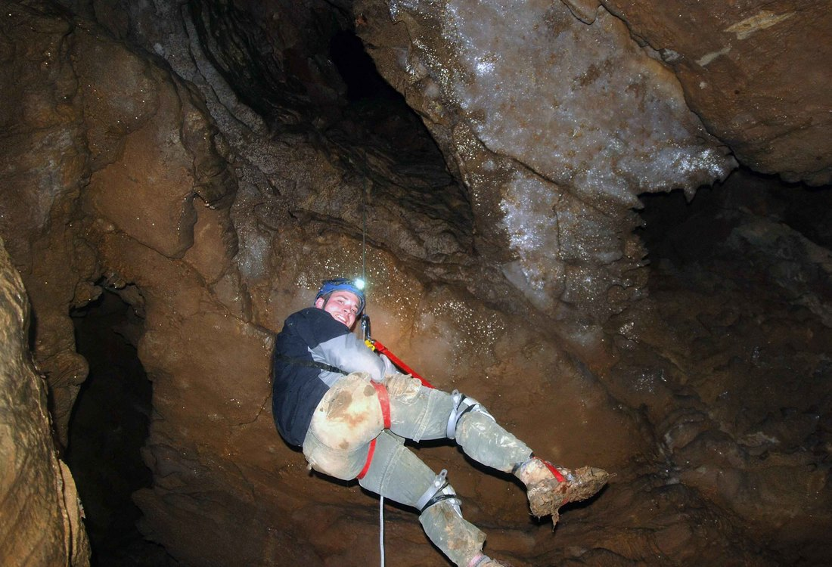

Slide 7
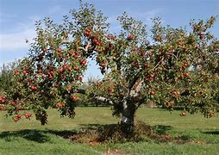
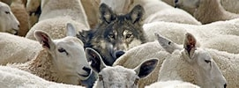
False prophets
False prophets are revealed by their fruit
They are as dangerous to the sheep of the kingdom, as wolves are to the sheep of the fields
Sin is an act of the will
Britain in the 21st Century is undergoing an immoral revolution
A healthy tree bears good fruit
A diseased tree bears bad fruit

Slide 8
Conclusion we must not interpret the bible through our experience we must interpret our experience through the Bible the holy spirit convicts of sin today we believe in the truth and that truth is Christ there is only one way and that way is Christ

