Slide 1
War and peace
Thinking biblically about conflict

Slide 2
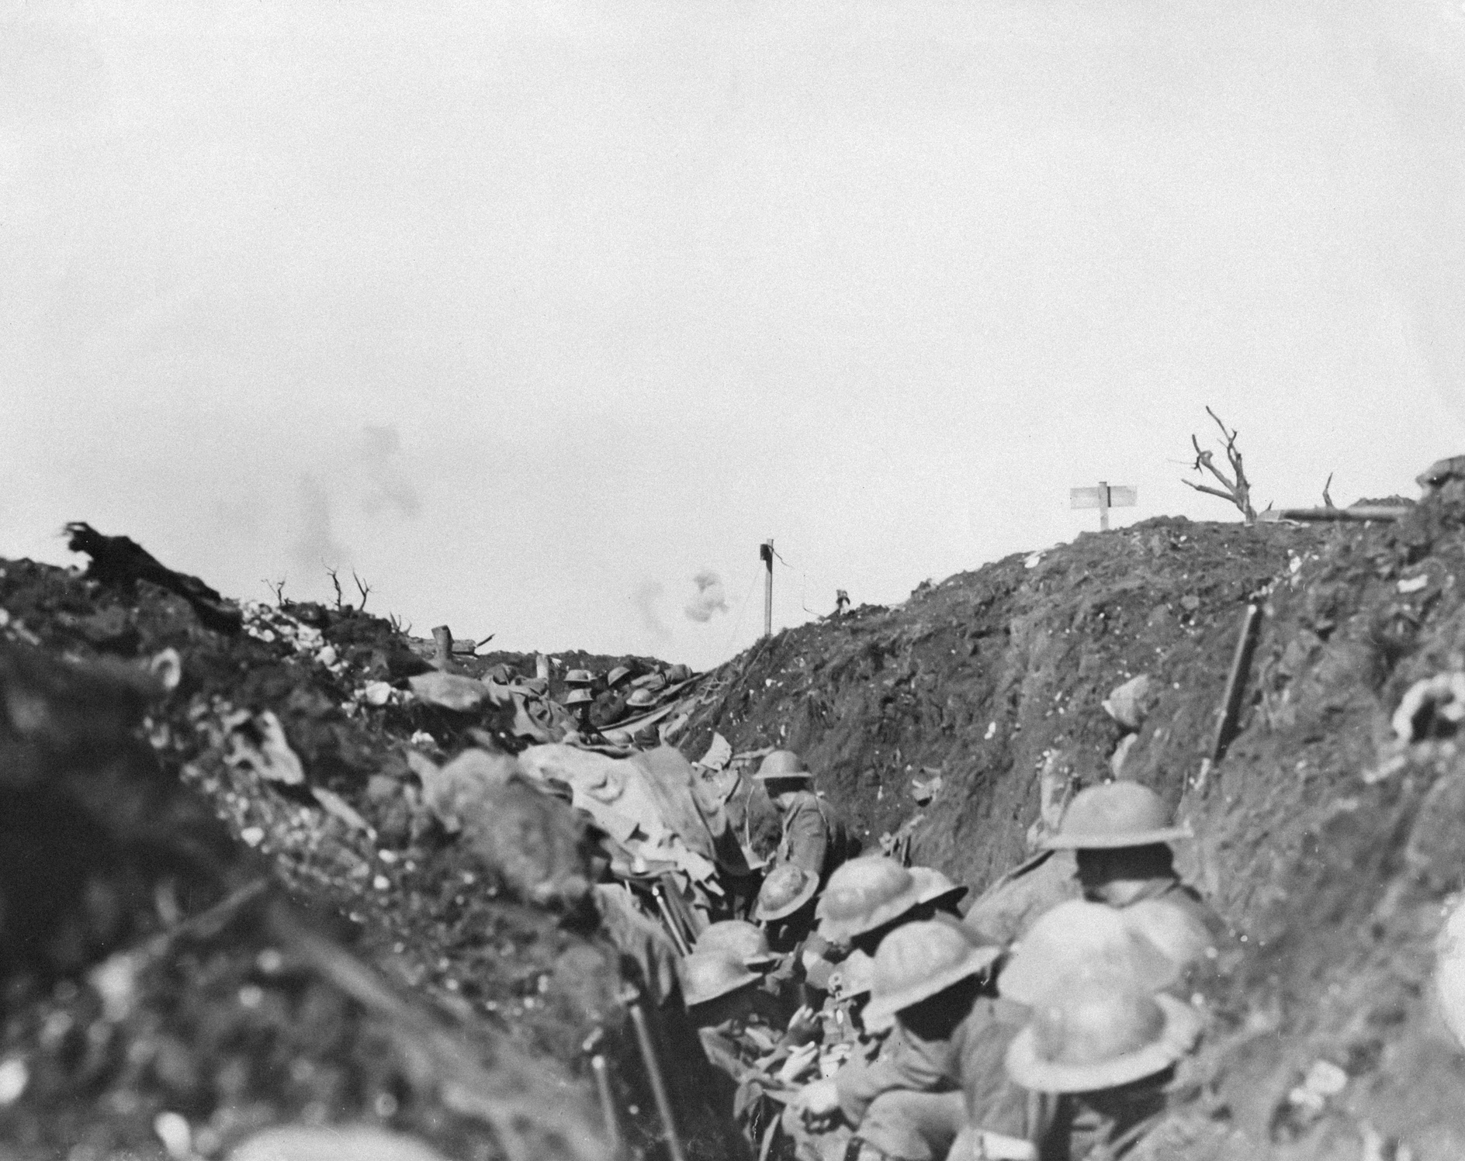

Slide 3
1) War is a feature of fallen life
2) War is a permissible reality
3) War and prayer

Slide 4
1) War is a feature of fallen life
1.1) War in present day: Current conflicts

Slide 5
1) War is a feature of fallen life
1.1) War in present day: Current conflicts
1.2) War in history

Slide 6
1) War is a feature of fallen life
1.1) War in present day: Current conflicts
1.2) War in history
1.3) War in story

Slide 7
1) War is a feature of fallen life
1.1) War in present day: Current conflicts
1.2) War in history
1.3) War in story
1.4) War in scripture

Slide 8
1) War is a feature of fallen life
1.1) War in present day: Current conflicts
1.2) War in history
1.3) War in story
1.4) War in scripture
1.5) War in the future

Slide 9
1) War is a feature of fallen life
1.1) War in present day: Current conflicts
1.2) War in history
1.3) War in story
1.4) War in scripture
1.5) War in the future
1.6) War and the Christian

Slide 10
2) War is a permissible reality
2.1) Christians can serve in the armed forces

Slide 11
2) War is a permissible reality
2.1) Christians can serve in the armed forces
Luke 3:14
Soldiers also asked him, “And we, what shall we do?” And he said to them, “Do not extort money from anyone by threats or by false accusation, and be content with your wages.” (ESV)

Slide 12
2) War is a permissible reality
2.1) Christians can serve in the armed forces
2.2) Nations can have armies

Slide 13
2.2) Nations can have armies
Rom 13:1-4
·‘Let every person be subject to the governing authorities. For there is no authority except from God, and those that exist have been instituted by God. 2 Therefore whoever resists the authorities resists what God has appointed, and those who resist will incur judgment. 3 For rulers are not a terror to good conduct, but to bad. Would you have no fear of the one who is in authority? Then do what is good, and you will receive his approval, 4 for he is God's servant for your good. But if you do wrong, be afraid, for he does not bear the sword in vain. For he is the servant of God, an avenger who carries out God's wrath on the wrongdoer.’ (ESV)

Slide 14
2) War is a permissible reality
2.1) Christians can serve in the armed forces
2.2) Nations can have armies
2.3) God is heaven’s commander in chief

Slide 15
2.3) God is heaven’s commander in chief
Joshua 5:1-5
13 When Joshua was by Jericho, he lifted up his eyes and looked, and behold, a man was standing before him with his drawn sword in his hand. And Joshua went to him and said to him, “Are you for us, or for our adversaries?” 14 And he said, “No; but I am the commander of the army of the Lord. Now I have come.” (ESV)

Slide 16
2.3) God is heaven’s commander in chief
2 Kings 6: 15-17
‘15 When the servant of the man of God rose early in the morning and went out, behold, an army with horses and chariots was all around the city. And the servant said, “Alas, my master! What shall we do?” 16 He said, “Do not be afraid, for those who are with us are more than those who are with them.” 17 Then Elisha prayed and said, “O Lord, please open his eyes that he may see.” So the Lord opened the eyes of the young man, and he saw, and behold, the mountain was full of horses and chariots of fire all around Elisha.’ (ESV)

Slide 17
2) War is a permissible reality
2.1) Christians can serve in the armed forces
2.2) Nations can have armies
2.3) God is heaven’s commander in chief
2.4) War in Christian thought

Slide 18
2) War is a permissible reality
2.1) Christians can serve in the armed forces
2.2) Nations can have armies
2.3) God is heaven’s commander in chief
2.4) War in Christian thought
2.5) Just war theory

Slide 19
2.5) Just war theory
1) Just cause

Slide 20
2.5) Just war theory
1) Just cause
2) Proportionate Cause

Slide 21
2.5) Just war theory
1) Just cause
2) Proportionate Cause
3) Right Intention

Slide 22
2.5) Just war theory
1) Just cause
2) Proportionate Cause
3) Right Intention
4) Right Authority

Slide 23
2.5) Just war theory
1) Just cause
2) Proportionate Cause
3) Right Intention
4) Right Authority
5) Reasonable Chance of Success

Slide 24
2.5) Just war theory
1) Just cause
2) Proportionate Cause
3) Right Intention
4) Right Authority
5) Reasonable Chance of Success
6) Last Resort

Slide 25
2.5) Just war theory
Moral requirements for the way war is fought

Slide 26
2.5) Just war theory
Moral requirements for when the war has finished

Slide 27
3) War and prayer

Slide 28
3) War and prayer
1) Soldiers currently serving in your nations armed forces

Slide 29
3) War and prayer
1) Soldiers currently serving in your nations armed forces
2) Leaders of countries

Slide 30
3) War and prayer
1) Soldiers currently serving in your nations armed forces
2) Leaders of countries
3) ·Nations currently at war

Slide 31
3) War and prayer
1) Soldiers currently serving in your nations armed forces
2) Leaders of countries
3) Nations currently at war
4) Conflicts to end

Slide 32
3) War and prayer
1) Soldiers currently serving in your nations armed forces
2) Leaders of countries
3) Nations currently at war
4) Conflicts to end
5) Guilty parties to find grace in Christ

